Slide 1

Project Title
“Computer Engineering”
An Ultimate Resource Management System
PRESENTATION – PROJECT IDEA & PROTOTYPE
Presentor: Pankaj Joshi || Bhuwan Chand

Slide 2
Introduction
A web-based system for managing academic resources.
Features include uploading, editing, reading, and organizing notes and materials.
Supports file types like PDFs and JPGs.
Designed for Computer Engineering students.

Slide 3
Objectives
Create a user-friendly platform for uploading and accessing resources.
Ensure seamless functionality across devices.
Allow users to categorize materials by semester, subject, or type.
Provide a robust search feature for quick access.

Slide 4
Key Features
Resource Management: Upload, delete, edit, and read materials.
Custom Sections: Users can create personalized categories.
Search Functionality: Find notes or materials quickly.
Mobile & Desktop Accessibility: Fully responsive design.

Slide 5


Slide 6
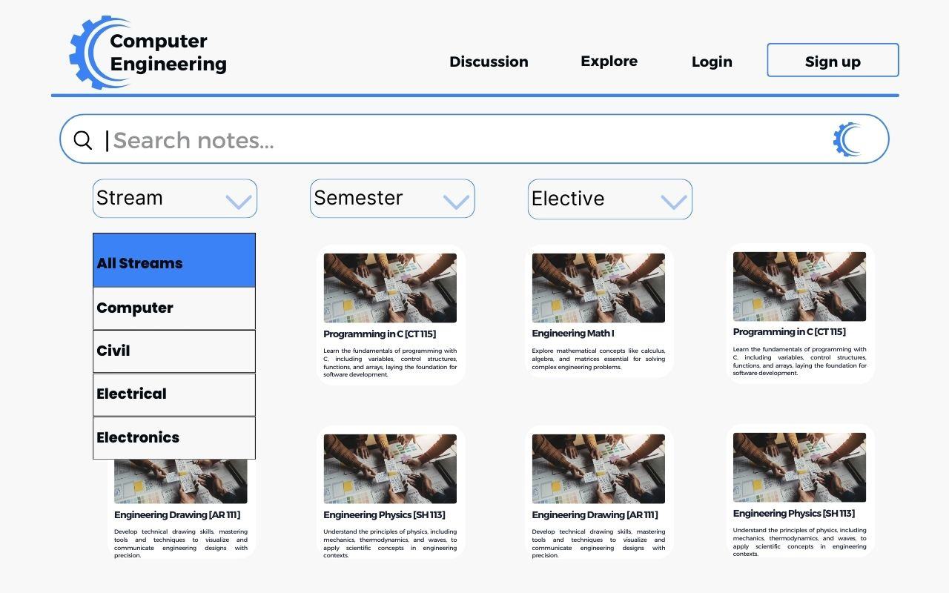

Slide 7
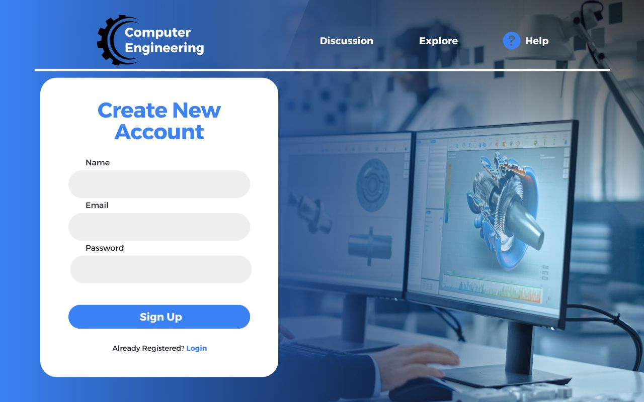

Slide 8
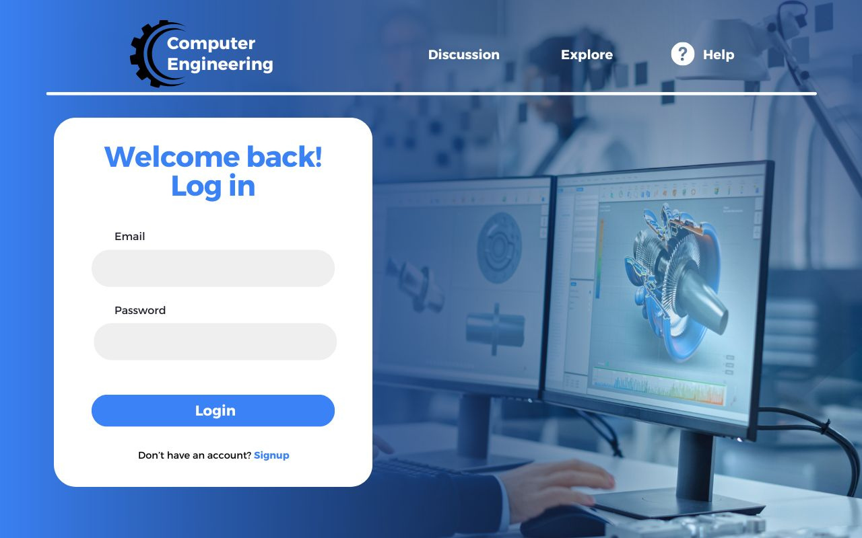

Slide 9
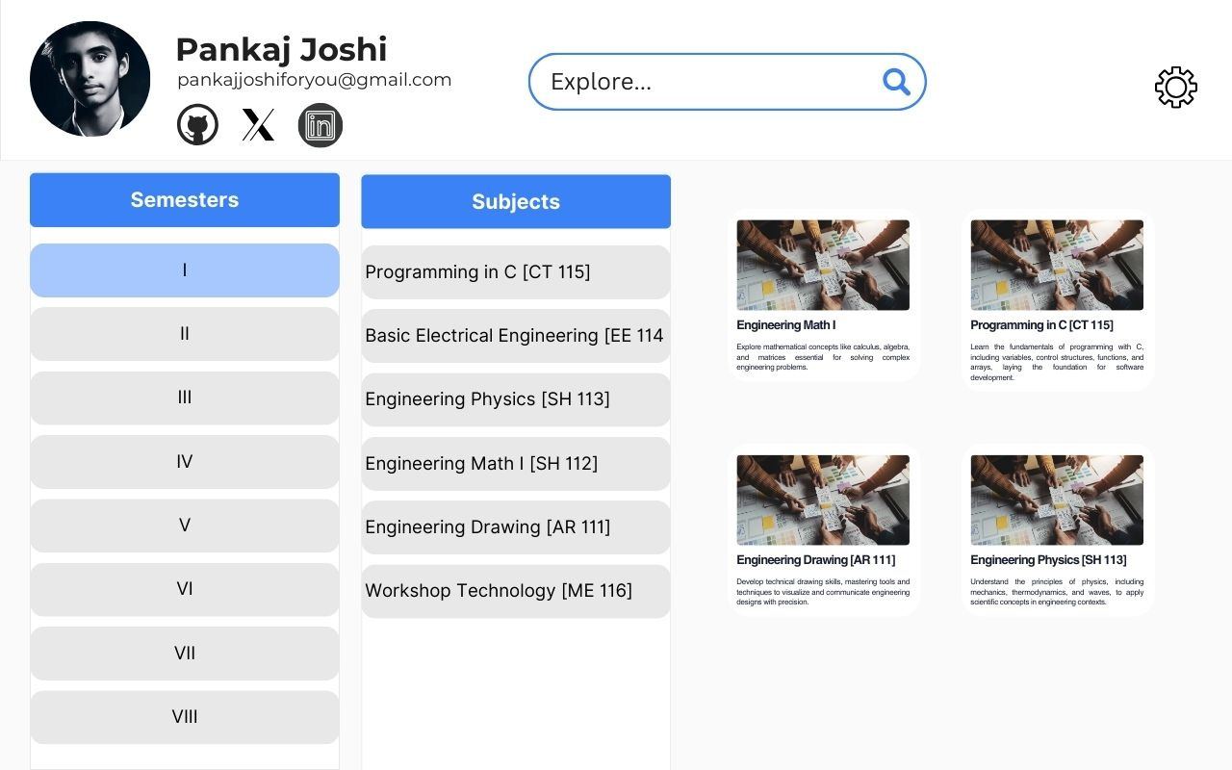

Slide 10
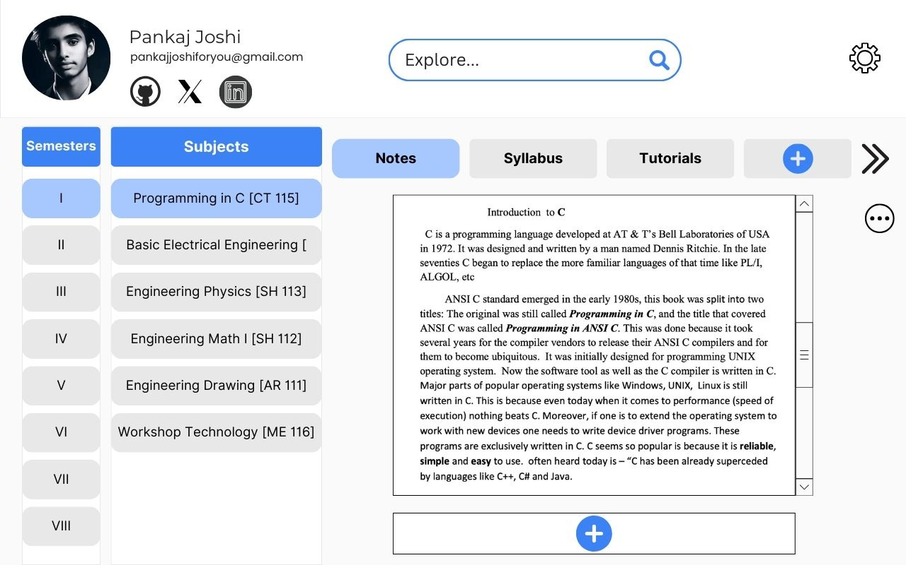

Slide 11



Frontend Development

Slide 12



Backend Development

Slide 13

Other Tools &
Technologies

Slide 14

Computer Engineering
THANK YOU
FOR YOUR ATTENTION

